Slide 1
Actor Concurrency Model
GEDex Day (Nov 12)
Bill Cheung
Brilly Tsang
Group Technology

Slide 2
Goal

Slide 3
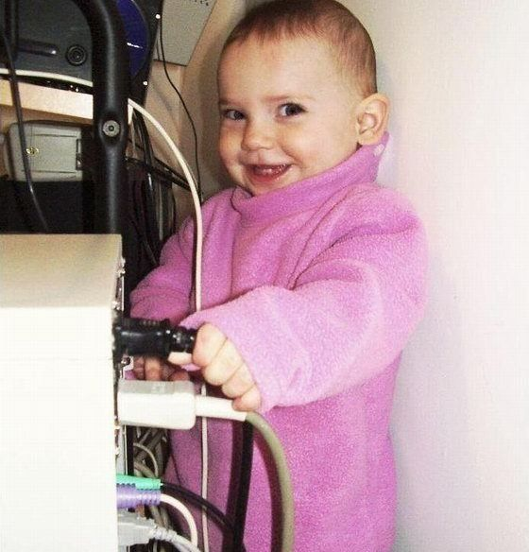
Why do we care?
Provides a reliable data tier with a single, consistent view of data
Enables dynamic data capacity including fault tolerance and load balancing
Ensures that data capacity scales with processing capacity

Slide 4
What is Actor?
1973 Historical Paper
Popularize by Erlang
Scala and JVM
http://doc.akka.io/docs/akka/snapshot/general/actors.html (draw the diagram for this)

Slide 5
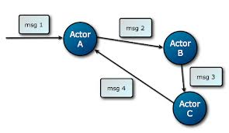
Actor
Notes:
Immutable Objects!

Slide 6
Actor Best Practice
Actors should be like nice co-workers
Do not pass mutable objects between actors..
Actors are made to be containers for behavior and state
Top-level actors are the innermost part of your Error Kernel.

Slide 7
Akka provides and guarantee
The actor send rule: the send of the message to an actor happens before the receive of that message by the same actor.
The actor subsequent processing rule: processing of one message happens before processing of the next message by the same actor.

Slide 8
Design Pre-requisite
Immutable messaging
Remote to local with optimization instead of local to remote generalization (http://labs.oracle.com/techrep/1994/smli_tr-94-29.pdf); hence no remote/local distinction and most are driven by configuration
Messages must be serializable including the setup in Prop
Async and data lost
Don’t expect the same thread will process two different messages
Simply and internalize the words

Slide 9
Akka – The Good, the Bad and the Ugly
Mature, good documentation
Paddling their ware such as installing their whole stack
Clumsy tutorial
Not really design for Java as a fundamental lang in mind

Slide 10
Scenarios
Computational intensive – Monte Carlo Simulation for Option TV
I/O Intensive – Calculate the portfolio value with fetching price from Yahoo

Slide 11
Scenarios
I/O Intensive
A portfolio
40 stocks with different shares
Get the price from Yahoo!
Calculate the total value

Slide 12
Scenarios
Y! Actor
Stock: APPLE
Price: 500
stocks
Main Actor
Stock: GOOGLE
Total Value =
( Stock * share * price )
Price: 600
Y! Actor

Slide 13
Scenarios
Computational intensive
Monte Carlo Simulation for Option TV

Slide 14
Fault- Tolerance
Two Strategies
All-For-One strategy
applies to all children
One-For-One strategy
applies to the failed one

Slide 15
Fault- Tolerance
restart()
resume()
terminate()
Exception!

Slide 16
Code
private static SupervisorStrategy strategy = new AllForOneStrategy(
3,
Duration.parse("5 seconds"),
new Function<Throwable, SupervisorStrategy.Directive>() {
@Override
public SupervisorStrategy.Directive apply(Throwable t) {
if (t instanceof StockDataNotFoundException) {
return terminate();
} else {
return escalate();
}
}
});

Slide 17
Actor and Scala

Slide 18
Actor Best Practice
Actors should be like nice co-workers: do their job efficiently without bothering everyone else needlessly and avoid hogging resources. Translated to programming this means to process events and generate responses (or more requests) in an event-driven manner. Actors should not block (i.e. passively wait while occupying a Thread) on some external entity—which might be a lock, a network socket, etc.—unless it is unavoidable; in the latter case see below
Do not pass mutable objects between actors. In order to ensure that, prefer immutable messages. If the encapsulation of actors is broken by exposing their mutable state to the outside, you are back in normal Java concurrency land with all the drawbacks.
Actors are made to be containers for behavior and state, embracing this means to not routinely send behavior within messages (which may be tempting using Scala closures). One of the risks is to accidentally share mutable state between actors, and this violation of the actor model unfortunately breaks all the properties which make programming in actors such a nice experience.
Top-level actors are the innermost part of your Error Kernel, so create them sparingly and prefer truly hierarchical systems. This has benefits wrt. fault-handling (both considering the granularity of configuration and the performance) and it also reduces the number of blocking calls made, since the creation of top-level actors involves synchronous messaging.
Simply and internalize the words

Slide 19
Best Practice
Actors should be like nice co-workers: do their job efficiently without bothering everyone else needlessly and avoid hogging resources. Translated to programming this means to process events and generate responses (or more requests) in an event-driven manner. Actors should not block (i.e. passively wait while occupying a Thread) on some external entity—which might be a lock, a network socket, etc.—unless it is unavoidable; in the latter case see below
Do not pass mutable objects between actors. In order to ensure that, prefer immutable messages. If the encapsulation of actors is broken by exposing their mutable state to the outside, you are back in normal Java concurrency land with all the drawbacks.
Actors are made to be containers for behavior and state, embracing this means to not routinely send behavior within messages (which may be tempting using Scala closures). One of the risks is to accidentally share mutable state between actors, and this violation of the actor model unfortunately breaks all the properties which make programming in actors such a nice experience.
Top-level actors are the innermost part of your Error Kernel, so create them sparingly and prefer truly hierarchical systems. This has benefits wrt. fault-handling (both considering the granularity of configuration and the performance) and it also reduces the number of blocking calls made, since the creation of top-level actors involves synchronous messaging.
Simply and internalize the words

Slide 20
Blocking strategies
Do the blocking call within an actor (or a set of actors managed by a router [Java, Scala]), making sure to configure a thread pool which is either dedicated for this purpose or sufficiently sized.
Do the blocking call within a Future, ensuring an upper bound on the number of such calls at any point in time (submitting an unbounded number of tasks of this nature will exhaust your memory or thread limits).
Do the blocking call within a Future, providing a thread pool with an upper limit on the number of threads which is appropriate for the hardware on which the application runs.
Dedicate a single thread to manage a set of blocking resources (e.g. a NIO selector driving multiple channels) and dispatch events as they occur as actor messages.
Simply and internalize the words

Slide 21
Akka provides and guarantee
Actor model
Other communication integration such as Camel
There may be millions of actors within one such system, after all the mantra is to view them as abundant and they weigh in at an overhead of only roughly 300 bytes per instance
Threads are share behind the scene
Ensure each actor is only run by one thread per activation (similar to Node.js in the sense that it handle the liveliness of the actor but never block. A task should be issue to the actor and that’s it. The framework will schedule the work to ensure cpu utilization)
Order of messages between two end points is ensure but not from other end points
Akka specific!! – cannot scan mailbox and only handle the next dequeue message. Hence order is encapsulated in mailbox strategy alone.
The actor send rule: the send of the message to an actor happens before the receive of that message by the same actor.
The actor subsequent processing rule: processing of one message happens before processing of the next message by the same actor.
Note
In layman's terms this means that changes to internal fields of the actor are visible when the next message is processed by that actor. So fields in your actor need not be volatile or equivalent.
Simply and internalize the words

Slide 22
Design Pre-requisite
Immutable messaging
Remote to local with optimization instead of local to remote generalization (http://labs.oracle.com/techrep/1994/smli_tr-94-29.pdf); hence no remote/local distinction and most are driven by configuration
Messages must be serializable including the setup in Prop
Async and data lost
Don’t expect the same thread will process two different messages
Simply and internalize the words

Slide 23
Akka – The Good, the Bad and the Ugly
Mature, good documentation
Paddling their ware such as installing their whole stack
Clumsy tutorial
Not really design for Java as a fundamental lang in mind

Slide 24
Scenarios
Computational intensive – Monte Carlo Simulation for Option TV
I/O Intensive - ???

Slide 25
Result discussion
Scale
code comparison

Slide 26
What you need to be aware of?
Test the scalability of different vendors
What hardware, software and language requirements are
How do they perform in WAN/LAN when someone kick the network cable and separated the cluster?
Requirements for object to be store in the grid
Supporting frameworks such as analytics, monitoring, transaction management and events processing

Slide 27
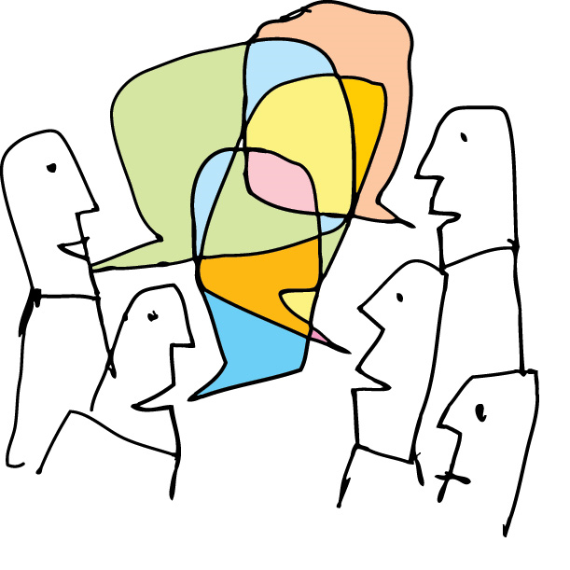
General Discussion
Any war stories related to In Memory Data Grid?
Do you think this is relevant to your project?
How can this simplify single application, distributed data and infrastructure setup?

